Slide 1
CS118 – Programming Fundamentals
Lecture # 09
Tuesday, September 18, 2019
FALL 2019
FAST – NUCES, Faisalabad Campus
Course Instructor:
Ebad Majeed
Slides Credit:
Rizwan Ul Haq

Slide 2
Quiz: 01
What will be the output of following statement in C++ and why?
Int a =5;
Cout <<a <<a++ << ++a <<++a + a++ <<endl;

Slide 3
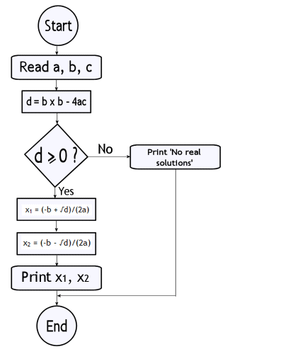
Control Structures
Start
Input a, b, c
disc = b² – 4ac
disc < 0
disc = 0
No
No
Output “No solution”
Output
X = (-b) / 4ac
Output
X1 = (-b + sqrt (disc)) / 4ac
X2 = (-b - sqrt (disc)) / 4ac
End

Slide 4
Control Structures
A computer can proceed:
In sequence
Selectively (branch): making a choice
Repetitively (iteratively): looping
Some statements are executed only if certain conditions are met
A condition is met if it evaluates to true

Slide 5
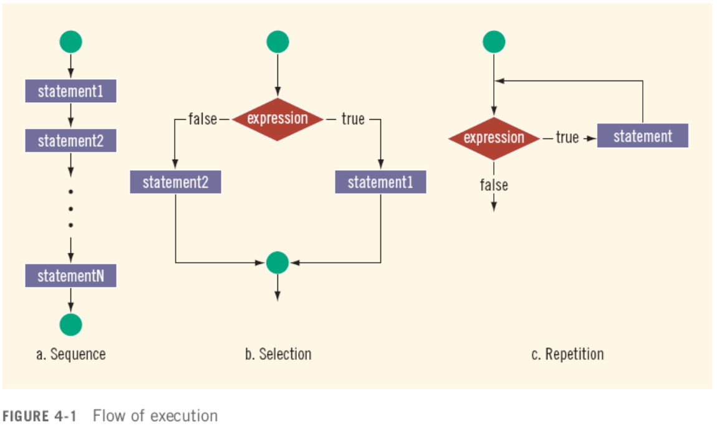
Control Structures (cont'd.)

Slide 6
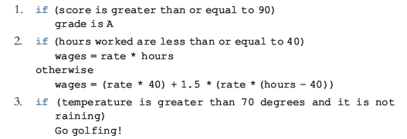
Control Structures (cont'd.)
You must understand the nature of conditional statements and how to use them.
Consider the following three statements:

Slide 7
Decision Making: Equality and Relational Operators
if structure
Decision based on truth or false of condition
If condition met, body executed
Else, body not executed
Equality and relational operators
Equality operators
Same level of precedence
Relational operators
Same level of precedence
Associate left to right

Slide 8
Decision Making: Equality and Relational Operators
Standard algebraic equality operator or relational operator | C++ equality or relational operator | Example of C++ condition | Meaning of C++ condition
Relational operators
> | > | x > y | x is greater than y
< | < | x < y | x is less than y
≥ | >= | x >= y | x is greater than or equal to y
≤ | <= | x <= y | x is less than or equal to y
Equality operators
= | == | x == y | x is equal to y
≠ | != | x != y | x is not equal to y

Slide 9
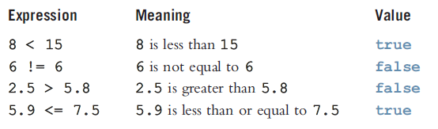
Relational Operators and Simple Data Types

Slide 10
Comparing Characters
Expression with relational operators
Depends on machine’s collating sequence
ASCII character set
Logical (Boolean) expressions
Expressions such as 4 < 6 and 'R' > 'T’
Returns an integer value of 1 if the logical expression evaluates to true
Returns an integer value of 0 otherwise

Slide 11
Comparison of Characters
For characters
Respective ASCIII values are compared
'R' > 'T' is false (82 > 84)
'+' < '*' is false (43 < 42)
'A' <= 'a' is true (65<97)

Slide 12
Relational and Equality Operators (cont.)
The relational operators have very low precedence and associate left-to-right
The equality operators have very-very low precedence and associate left-to-right
Some examples:
17 < x foo == 3.14
age != 21 x+1 >= 4*y-z

Slide 13
Precedence
Operators Precedence
() highest (applied first)
* / %
+ -
< <= > >=
== !=
=
lowest (applied last)

Slide 14
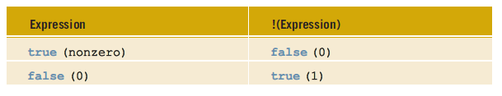
Logical (Boolean) Operators and Logical Expressions
Operator | Description
! | NOT
&& | AND
|| | OR

Slide 15

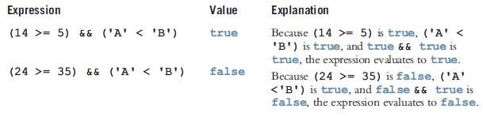
Conti…
AND & OR operators work just like AND/OR-Gate as you studied in Physics in intermediate
AND = True iff all conditions are TRUE
OR = False iff all results are FASLE

Slide 16
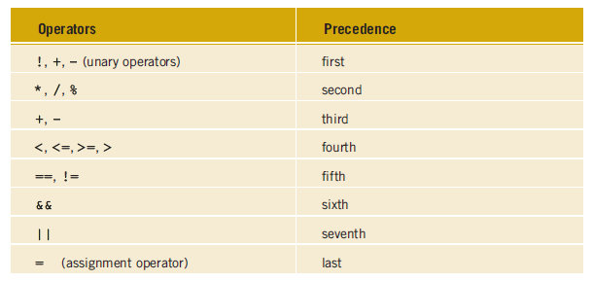
Order of precedence

Slide 17
Suppose you have the following declarations
bool found = true ;
int age = 20 ;
double hours = 45.30 ;
double overtime = 15.00 ;
int count = 20;
char ch = 'B';
Expression | Value / Expression
!found | false Because found is true, !found is false
hours > 40.0 | true Because hours is 45.3 and 45.3 > 40.0 is true, the expression hours > 40.0 evaluates to true
!age | false Age is 20, which is non zero so age is true. Therefore !age is false
!found && (age >=18) | false !found is false; age >= 18 is 20 >= 18 is true. Therefore !found && (age >=18) is false && true, which evaluates to false

Slide 18
bool found = true ;
int age = 20 ;
double hours = 45.30 ;
double overTime = 15.00 ;
int count = 20;
char ch = 'B';
Expression | Value / Expression
hours + overTime <= 75.0 | true hours + overTime is 45.30 + 15.00 = 60.30 and 60.30 <= 75.0 is true, it follows that hours + overtime <= 75 evaluates to true
(count >= 0) && (count <= 100) | true Now count is 20, Because 20 >= 0 is true, count >=0 is true. Also 20 <= 100 is true, count <=100 is true. Therefore (count >= 20) && (count <= 100) is true & true, which evaluates to true
(‘A’ <= ch && ch <= ‘Z’) | true Here ch is ‘B’. Because ‘A’ <= ‘B’ is true, ‘A’ <= ch evaluates to true. Also, because ‘B’ <= ‘Z’ is true, ch <= ‘Z’ evaluates to true. Therefore (‘A’ <= ch && ch <= ‘Z’) is true && true evaluates to true.

Slide 19
Relational Operators
A condition is represented by a logical (Boolean) expression that can be true or false
Relational operators:
Allow comparisons
Require two operands (binary)
Evaluate to true or false

Slide 20
Relational Operators (cont'd.)

Slide 21
Relational Operators and Simple Data Types
You can use the relational operators with all three simple data types:
8 < 15 evaluates to true
6 != 6 evaluates to false
2.5 > 5.8 evaluates to false
5.9 <= 7.5 evaluates to true

Slide 22
Relational Operators and the string Type
Relational operators can be applied to strings
Strings are compared character by character, starting with the first character
Comparison continues until either a mismatch is found or all characters are found equal
If two strings of different lengths are compared then the comparison is equal to the last character of the shorter string
The shorter string is less than the larger string
Bill >= Billy //False

Slide 23
Relational Operators and the string Type (cont'd.)
Suppose we have the following declarations:
string str1 = "Hello";
string str2 = "Hi";
string str3 = "Air";
string str4 = "Bill";
string str4 = "Big";

Slide 24
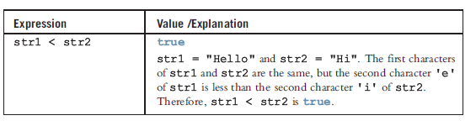
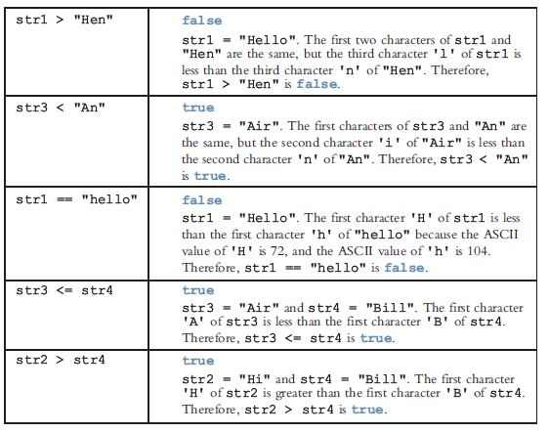
Relational Operators and the string Type (cont'd.)
string str1 = "Hello";
string str2 = "Hi";
string str3 = "Air";
string str4 = "Bill";
string str4 = "Big";

Slide 25
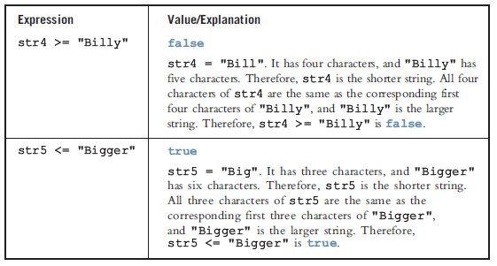
Relational Operators and the string Type (cont'd.)
string str1 = "Hello";
string str2 = "Hi";
string str3 = "Air";
string str4 = "Bill";
string str4 = "Big";

Slide 26
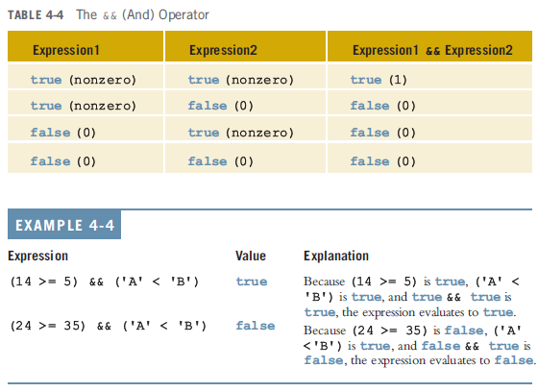
Logical (Boolean) Operators and Logical Expressions (cont'd.)

Slide 27
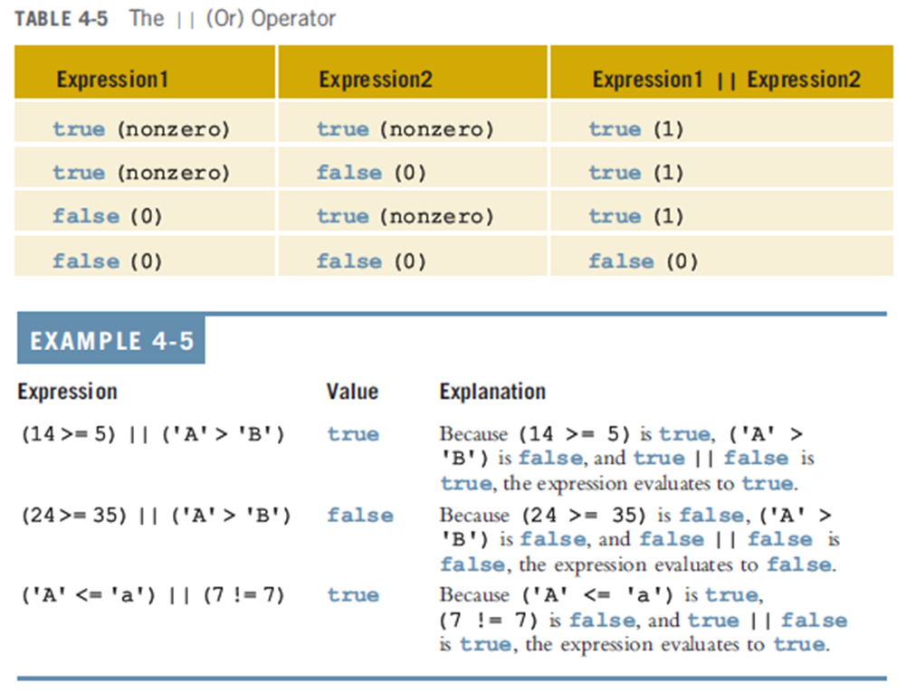
Logical (Boolean) Operators and Logical Expressions (cont'd.)

Slide 28
int Data Type and Logical (Boolean) Expressions
Earlier versions of C++ did not provide built-in data types that had Boolean values
Logical expressions evaluate to either 1 or 0
The value of a logical expression was stored in a variable of the data type int
You can use the int data type to manipulate logical (Boolean) expressions

Slide 29
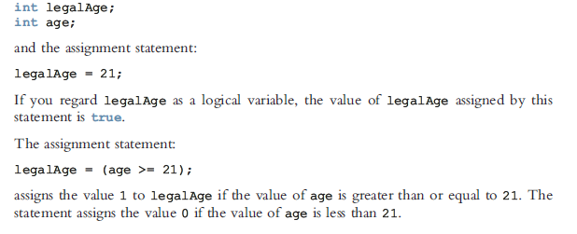
int Data Type and Logical (Boolean) Expressions

Slide 30
The bool Data Type and Logical (Boolean) Expressions
The data type bool has logical (Boolean) values true and false
bool, true, and false are reserved words
The identifier true has the value 1
The identifier false has the value 0
legalAge= (age>=21);

Slide 31
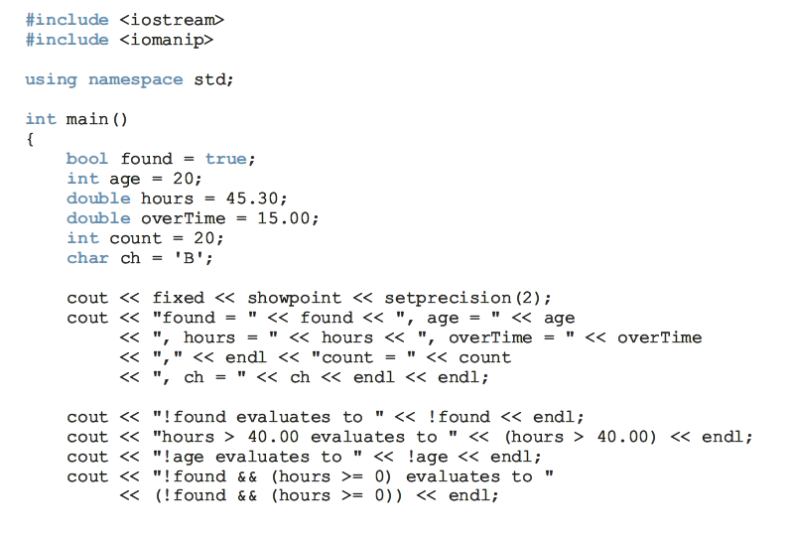
Programming Example:

Slide 32
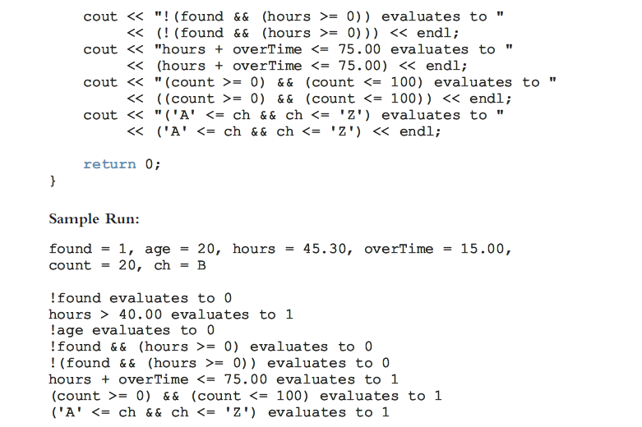

Slide 33
Selection: if and if...else
One-Way Selection
Two-Way Selection
Compound (Block of) Statements
Multiple Selections: Nested if
Comparing if...else Statements with a Series of if Statements

Slide 34
One-Way Selection
The syntax of one-way selection is:
The statement is executed if the value of the expression is true
The statement is bypassed if the value is false; program goes to the next statement
if is a reserved word

Slide 35
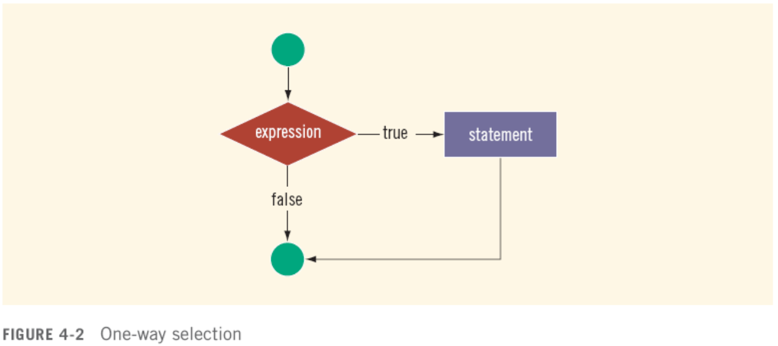
One-Way Selection (cont'd.)

Slide 36
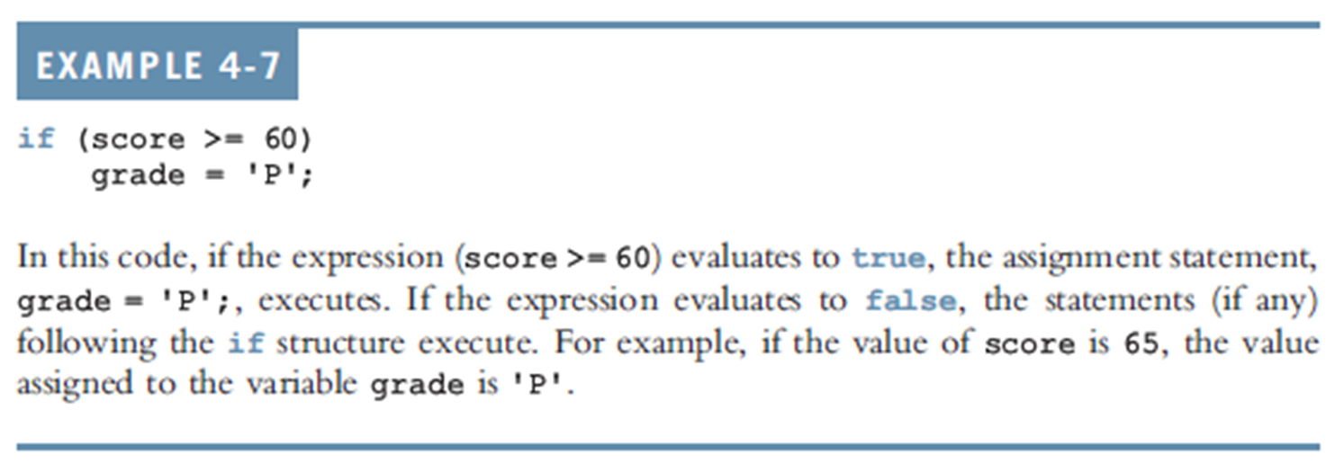
One-Way Selection (cont'd.)

Slide 37
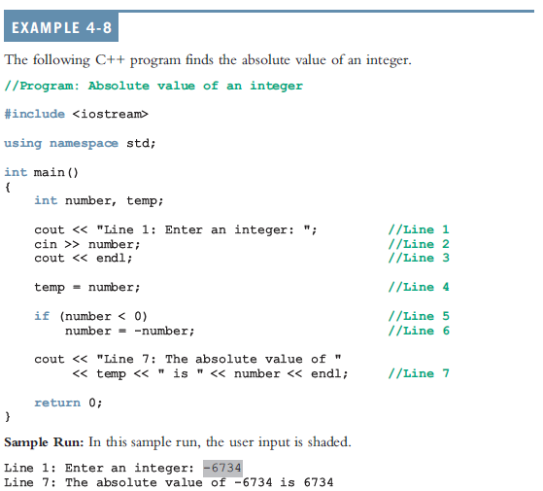

Slide 38
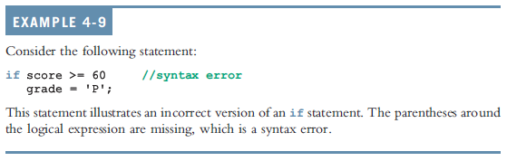
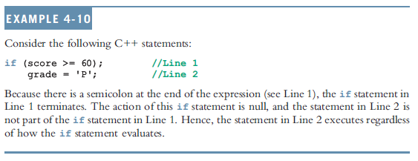
One-Way Selection (cont'd.)

Slide 39
Two-Way Selection
Two-way selection takes the form:
If expression is true, statement1 is executed; otherwise, statement2 is executed
statement1 and statement2 are any C++ statements
else is a reserved word

Slide 40
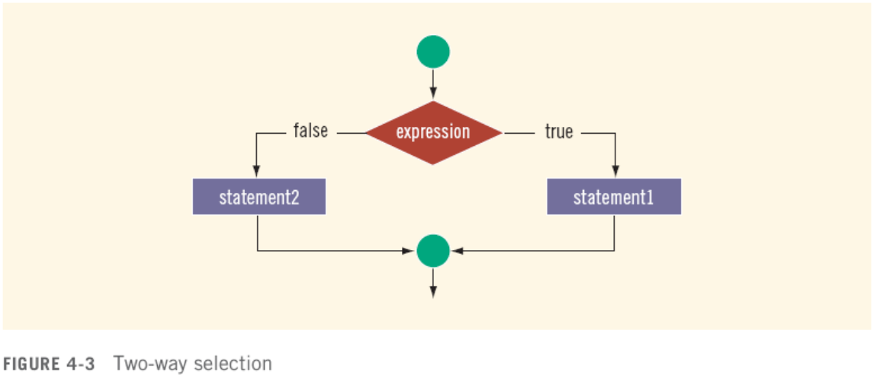
Two-Way Selection (cont'd.)

Slide 41
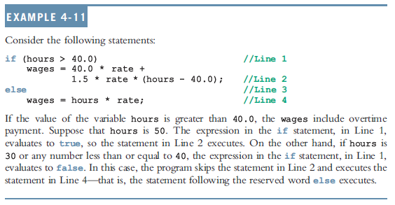
Two-Way Selection (cont'd.)

Slide 42
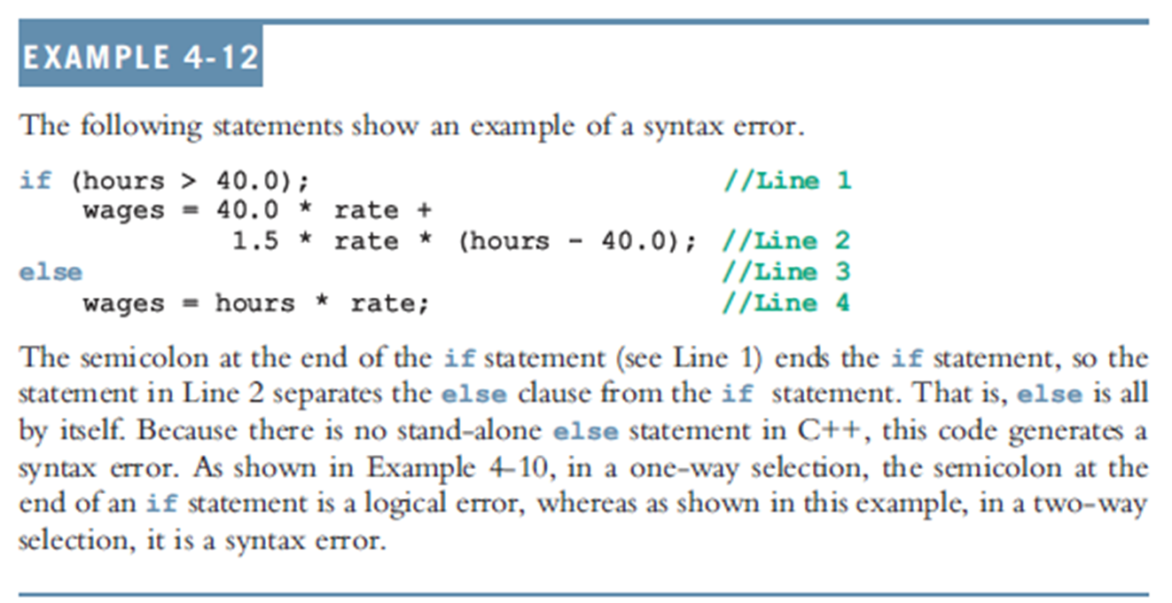
Two-Way Selection (cont'd.)

Slide 43
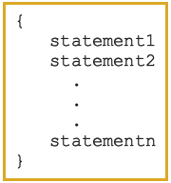
Compound (Block of) Statements
Compound statement (block of statements):
A compound statement is a single statement

Slide 44
Compound (Block of) Statements (cont'd.)
if (age > 18)
{
cout << "Eligible to vote." << endl;
cout << "No longer a minor." << endl;
}
else
{
cout << "Not eligible to vote." << endl;
cout << "Still a minor." << endl;
}

Slide 45
Multiple Selections: Nested if
Nesting: One control statement in another
An else is associated with the most recent if that has not been paired with an else

Slide 46
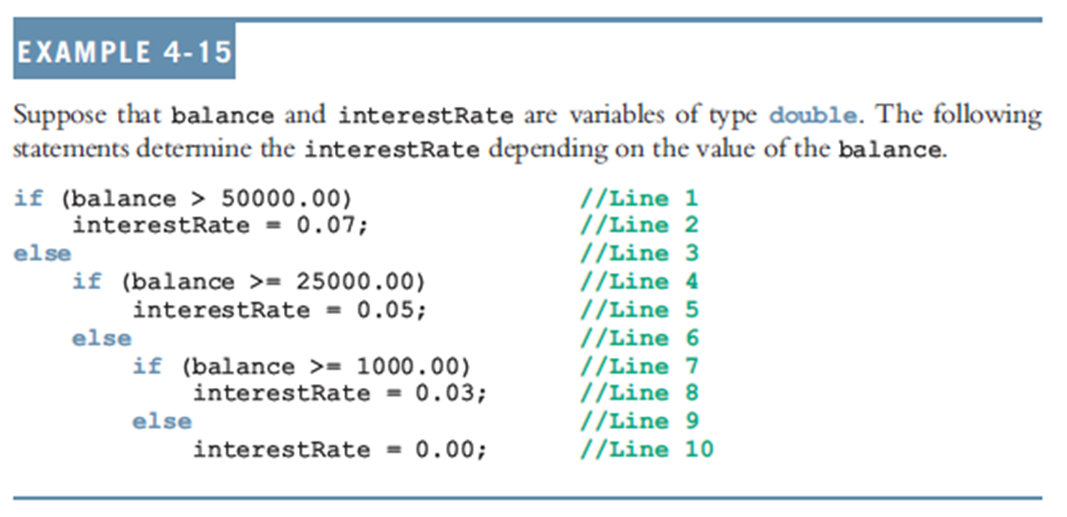
Multiple Selections: Nested if (cont'd.)

Slide 47
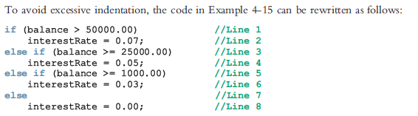
Multiple Selections: Nested if (cont'd.)

Slide 48
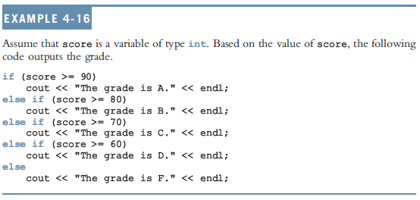
Multiple Selections: Nested if (cont'd.)

Slide 49
if-else Pairing
Assume that all the variables are properly declared and consider the following statements:
if(gender == 'M') //Line 1
if(age < 21) //Line 2
policyRate = 0.05; //Line 3
else //Line 4
policyRate = 0.035; //Line 5
else if (gender = 'F') //Line 6
if(age < 21) //Line 7
policyRate = 0.04; //Line 8
else //Line 9
policyRate = 0.03; //Line 10
In this code, the else in Line 4 is paired with the if in Line 2. Note that for the else in Line 4, the most recent incomplete if is the if in Line 2. The else in Line 6 is paired with the if in Line 1. The else in Line 9 is paired with the if in Line 7. Once again the indentation does not determine the pairing, but it communicates the pairing

Slide 50
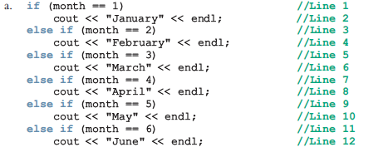
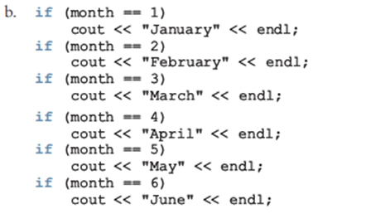
Comparing if…else Statements with a Series of if Statements

Slide 51
Short-Circuit Evaluation
Short-circuit evaluation: evaluation of a logical expression stops as soon as the value of the expression is known
Example:
Assume x = 21, y=5, z = 3, ch = ‘B’
(x >= 20) || ( y == 10) //Line 1
(ch == 'A') && (z < 7) //Line 2

Slide 52
Comparing Floating-Point Numbers for Equality: A Precaution
Comparison of floating-point numbers for equality may not behave as you would expect
Example:
1.0 == 3.0/7.0 + 2.0/7.0 + 2.0/7.0 evaluates to false
Why? 3.0/7.0 + 2.0/7.0 + 2.0/7.0 = 0.99999999999999989
Solution: use a tolerance value
Example: fabs(x – y) < 0.000001

Slide 53
#include<iostream>
#include <iomanip>
#include<cmath>
using namespace std;
int main()
{
double x =1.0;
double y = 3.0 / 7.0 + 2.0 / 7.0 + 2.0 / 7.0 ;
cout << fixed << showpoint << setprecision(17);
cout << "3.0 / 7.0 + 2.0 / 7.0 + 2.0 / 7.0 = "
<< 3.0 / 7.0 + 2.0 / 7.0 + 2.0 / 7.0 << endl;
cout << "x = " << x << endl << "y = " << y << endl;
if(x == y)
cout << "x and y are same" <<endl;
else
cout << "x and y are not same" << endl;
if (fabs(x-y)<0.000001)
cout << "x and y are same within the tolerance 0.000001" << endl;
else
cout << "x and y are not same within the tolerance 0.000001" << endl;
return 0;
}
Sample Run:
3.0 / 7.0 + 2.0 / 7.0 + 2.0 / 7.0 = 0.99999999999999989
x = 1.00000000000000000
y = 0.99999999999999989
x and y are not the same.
x and y are the same within the tolerance 0.000001.

Slide 54
Questions

